Slide 1
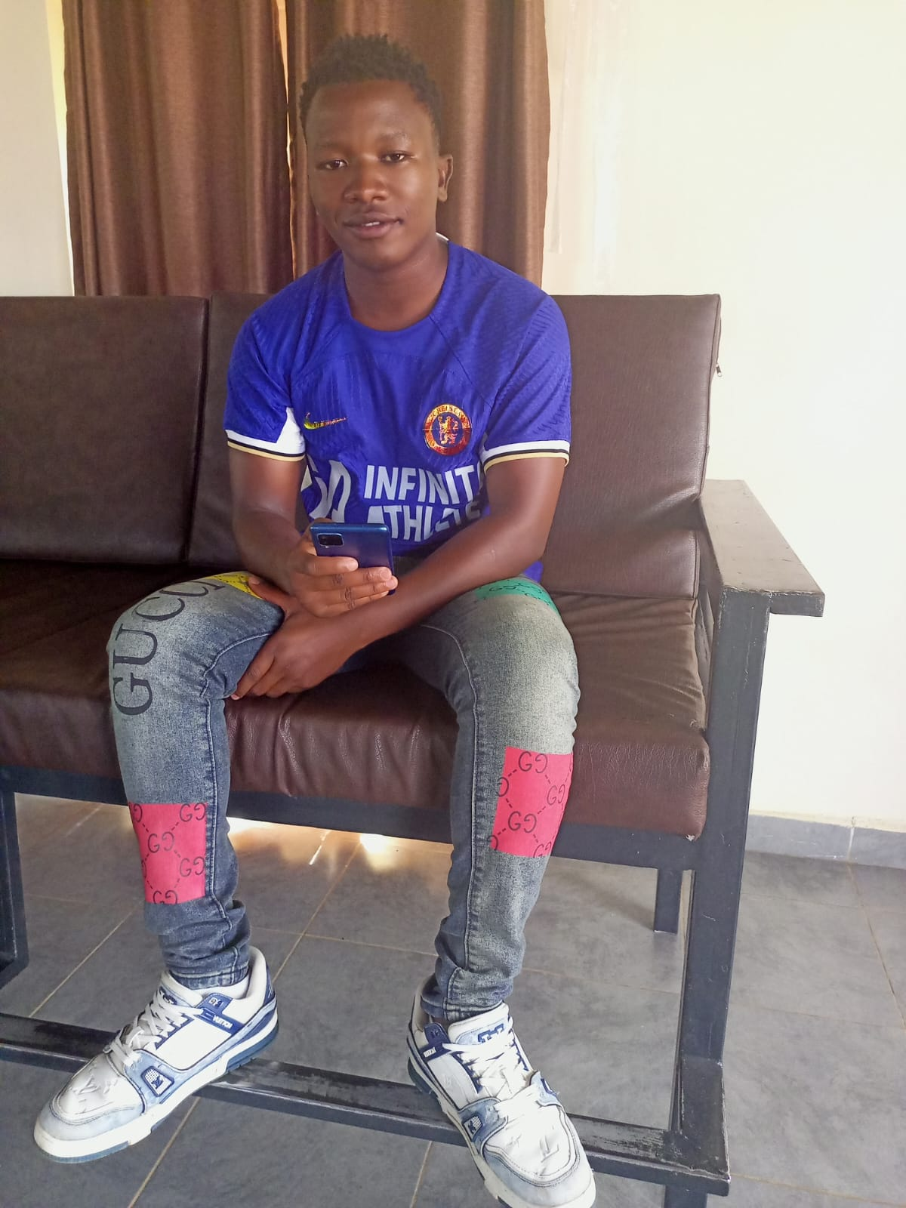
My Autobiography
Shadrack Muthami Kitheka

Slide 2
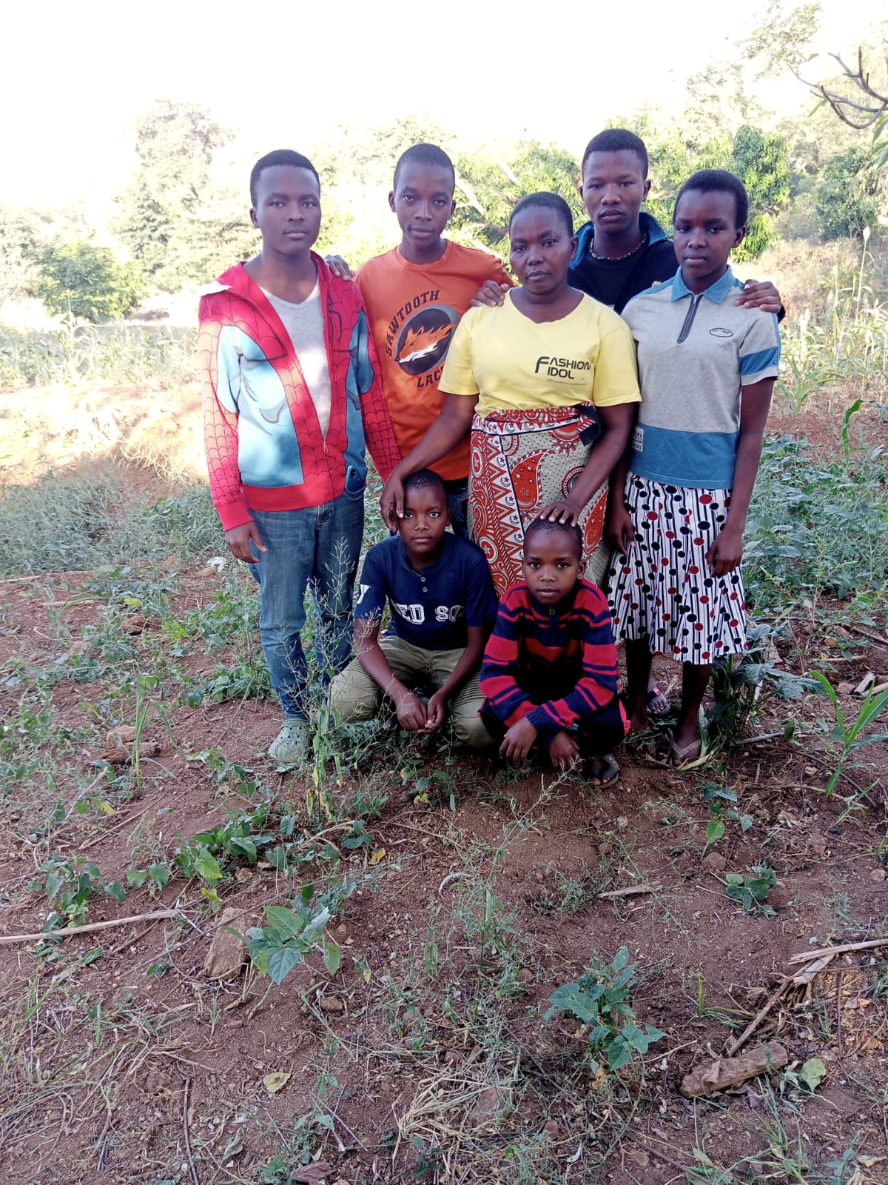
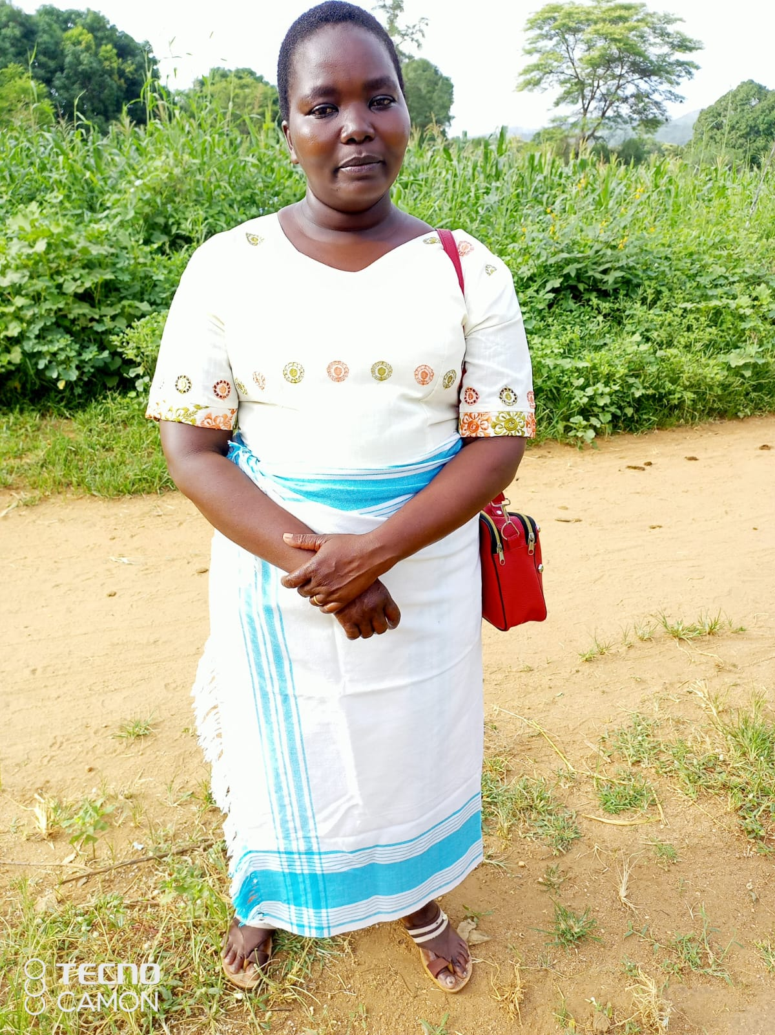
Early Life and Family Background
Early Life and Family Background
Born in Mumbuni village, Kitui County, Kenya.
Belonging to the Kamba community.
Parents: Gladys Kuthea Kitheka and the
late Andrew Kitheka Kimanzi.
Second-born in a family of six children.
My siblings
My Mom, Gladys

Slide 3
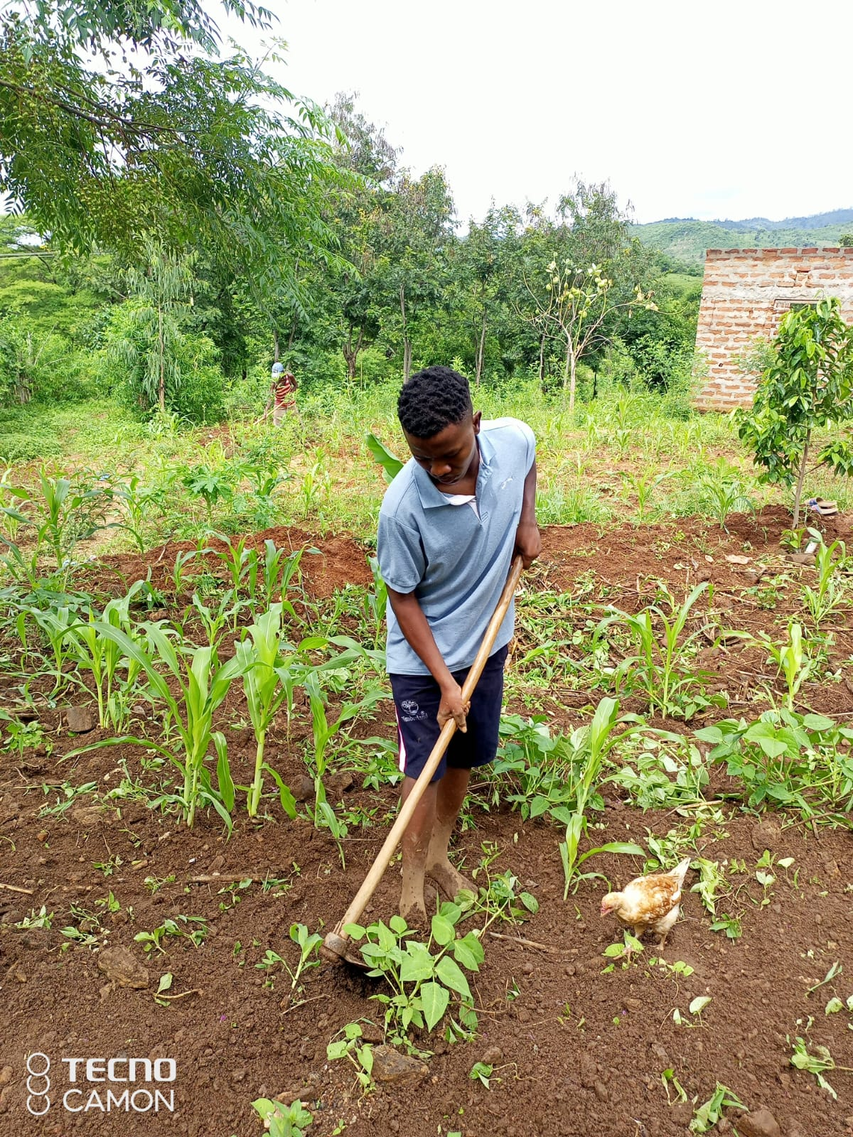
Growing Up in Mumbuni Village
Farming activities and responsibilities.
Role in raising younger siblings.
Community and cultural experiences.

Slide 4
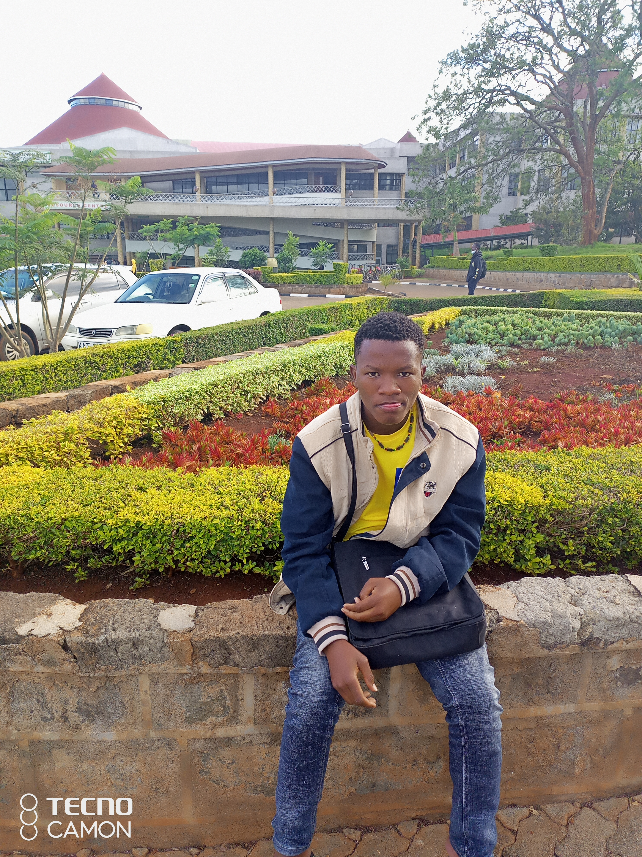
Educational Journey
Mutulu Primary School, Riverside Academy,
Unyaa Primary School.
High school at Migwani Boys High School.
Transition to Dedan Kimathi University of
Technology (DEKUT).

Slide 5
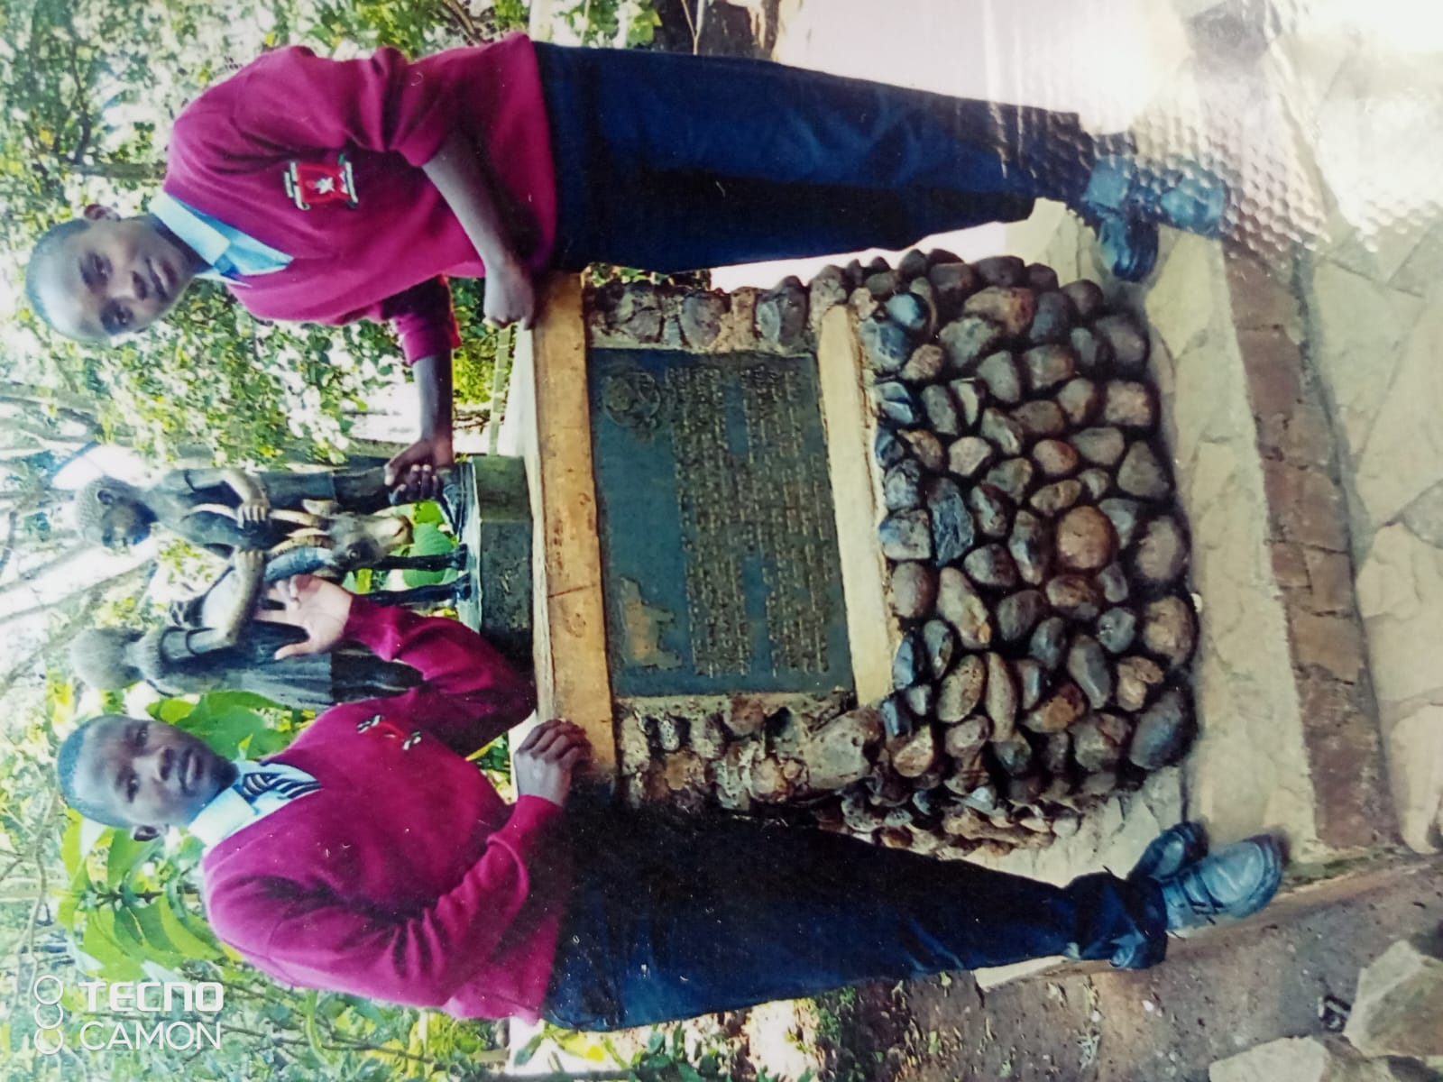
High School Years
Involvement in extracurricular activities like
hockey and the Wildlife Club.
Leadership roles: Hockey team captain and
Wildlife Club chairperson.

Slide 6
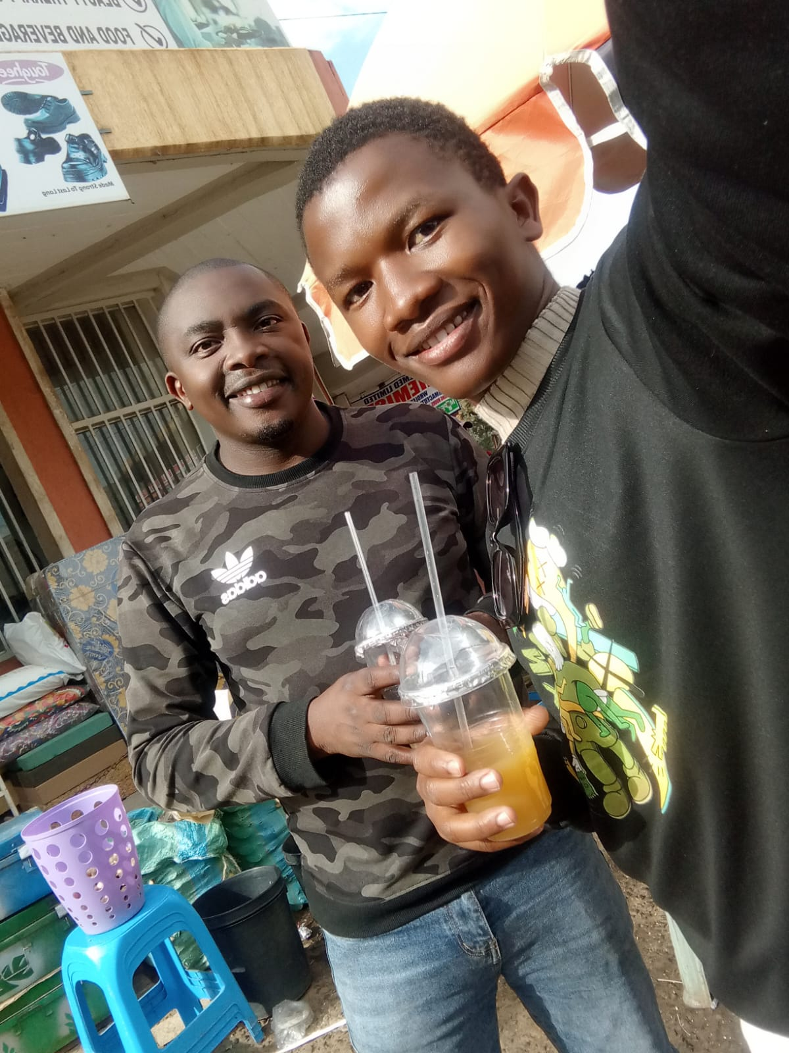
Mentorship
Recognizing a Special Mentor
Kiswahili teacher Mr. Ndeto and his influence.
Achievements under his guidance, especially
in Kiswahili.

Slide 7
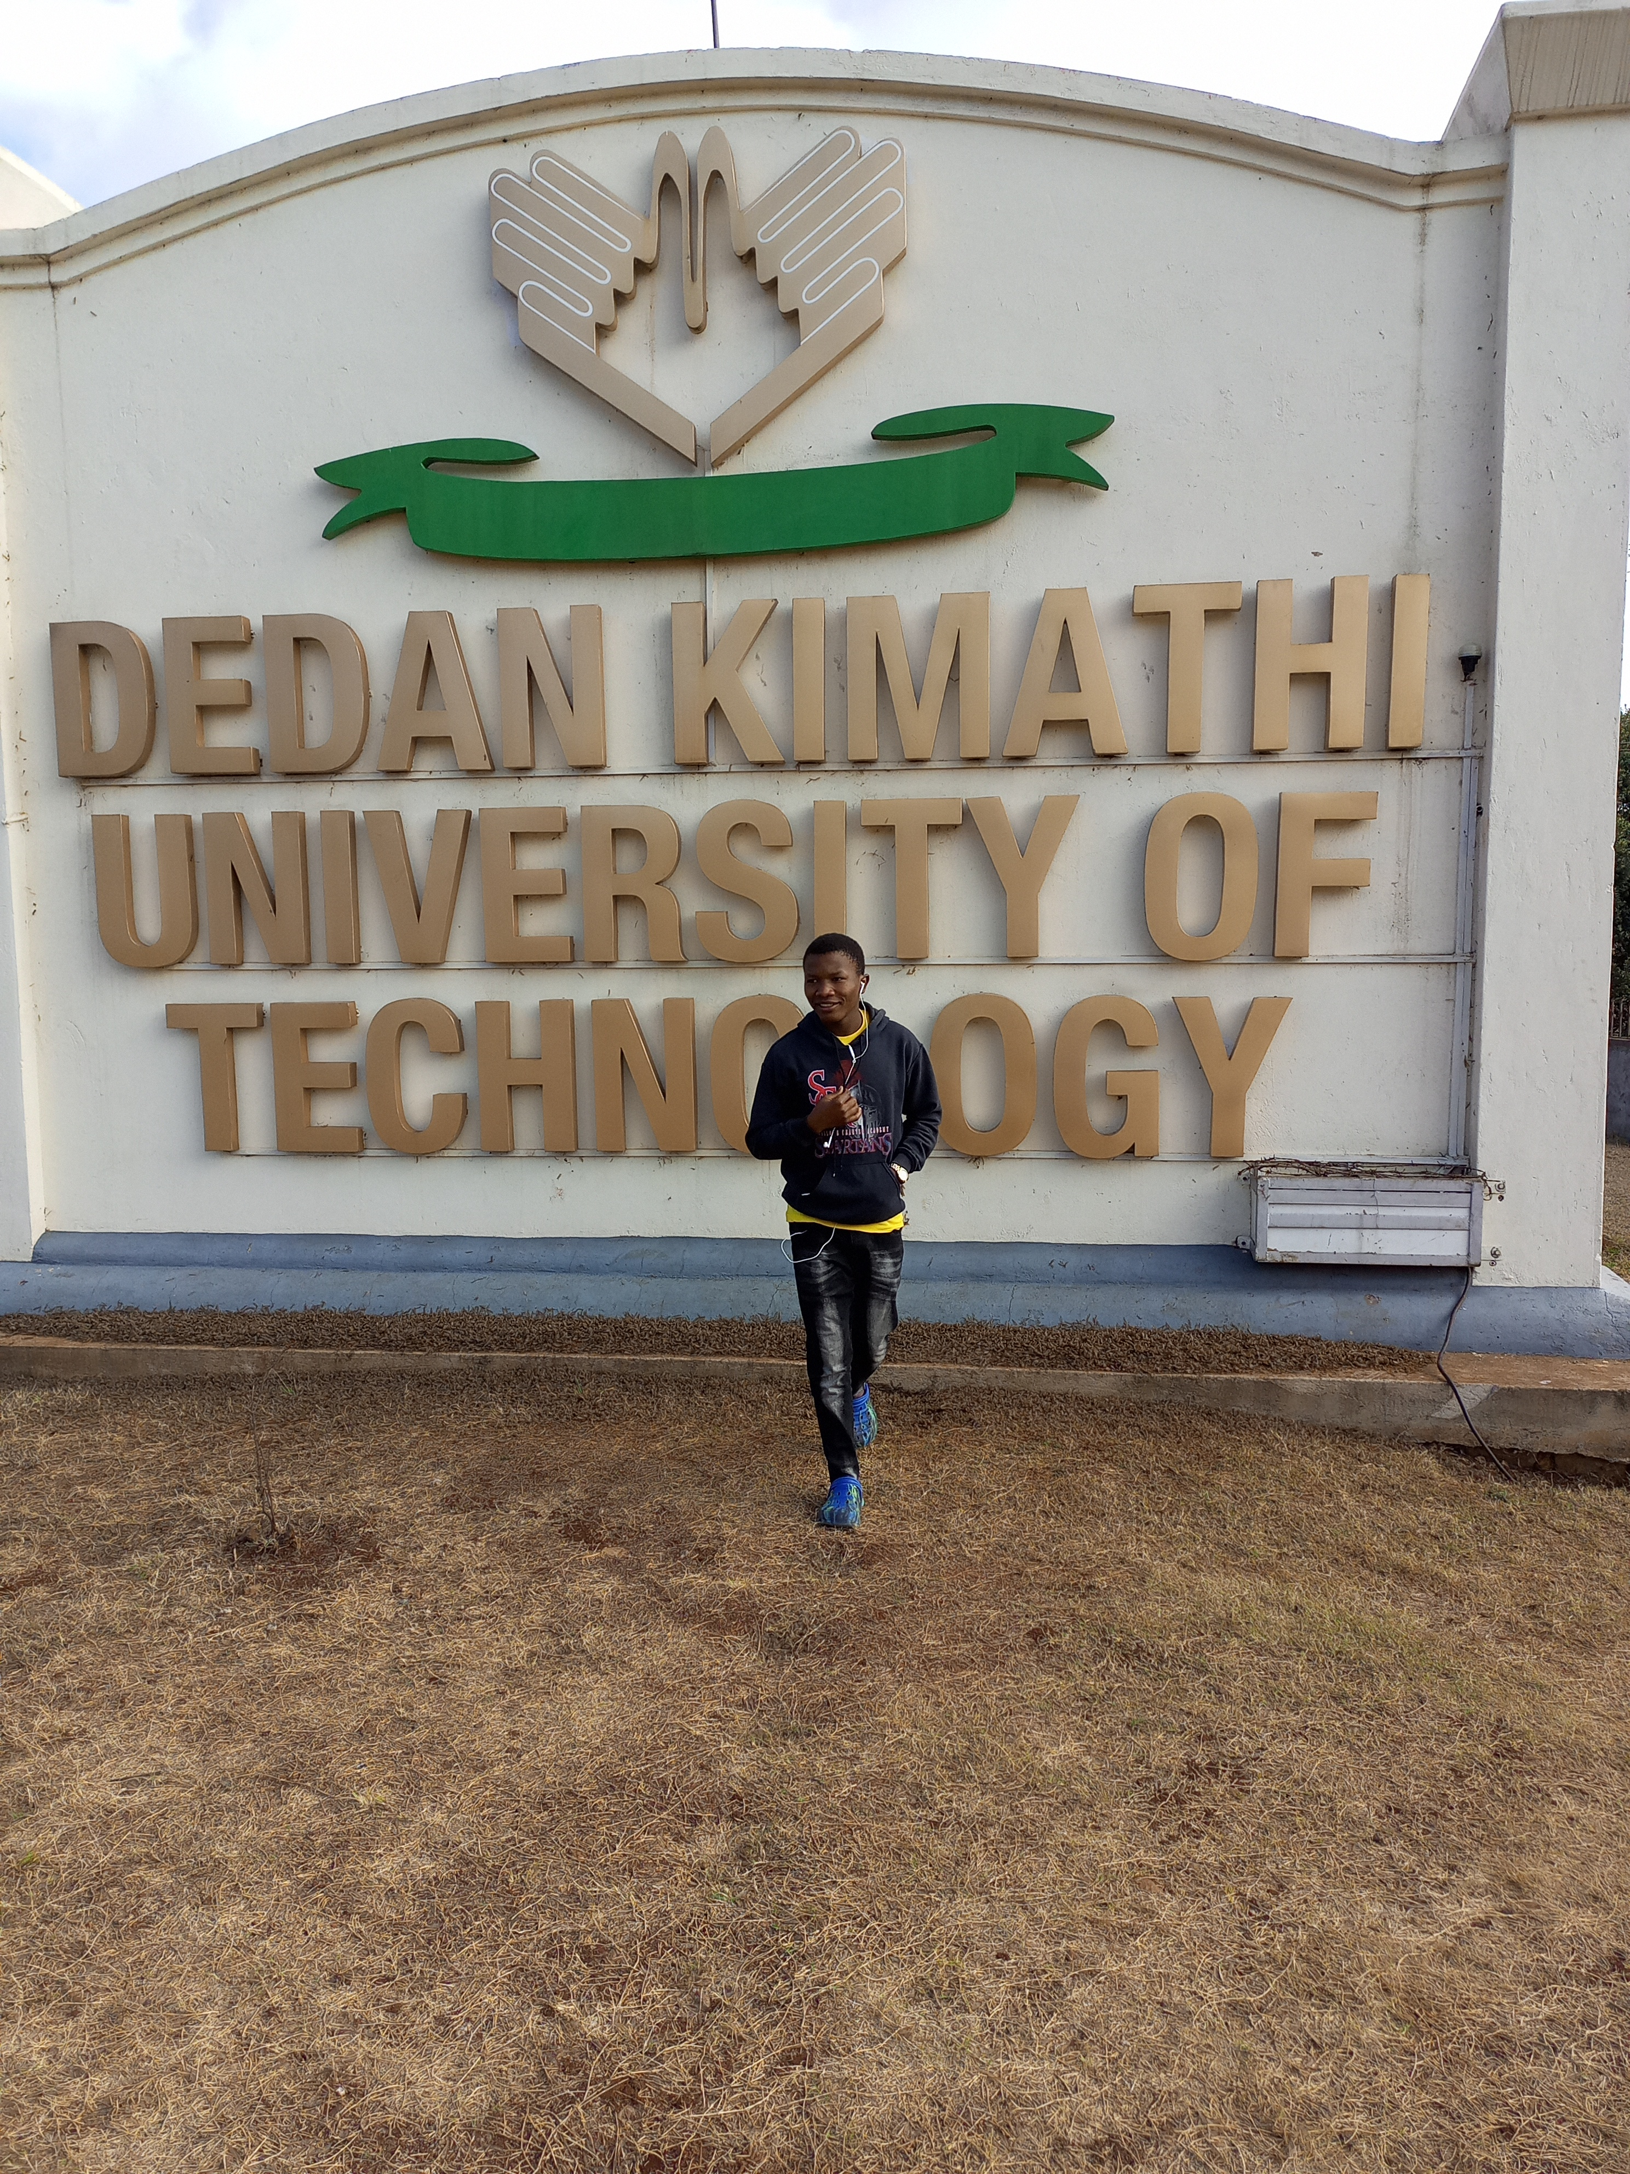
University Life
Pursuing BBIT at DEKUT.
Final year and academic achievements.
Extracurricular activities and personal growth.

Slide 8
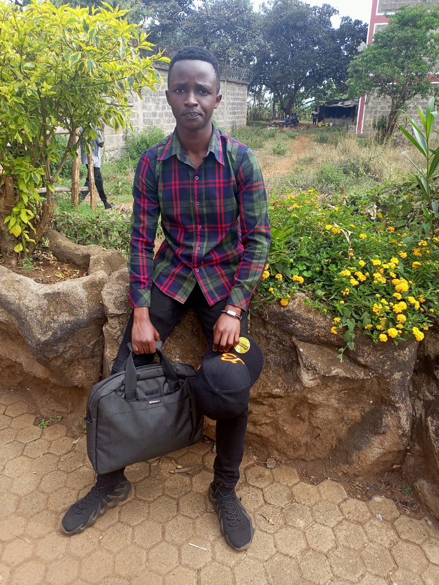
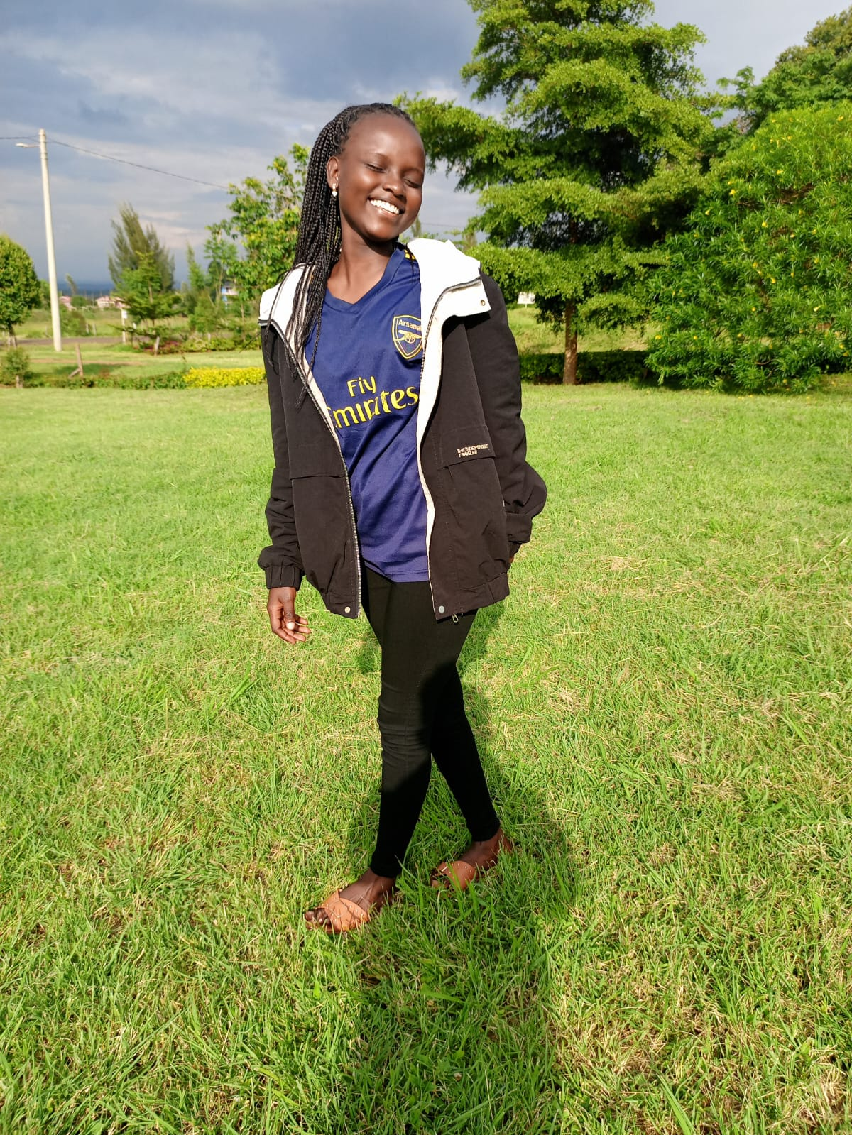
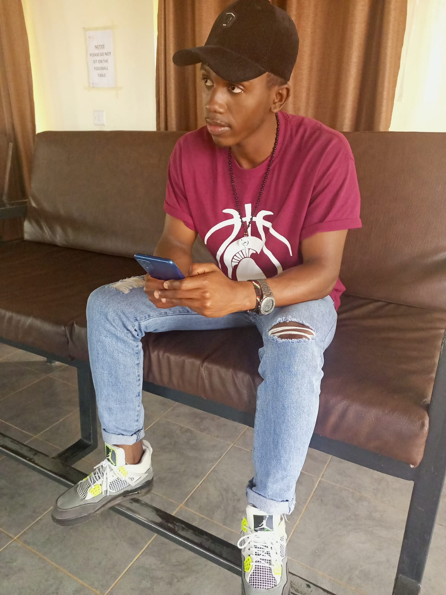
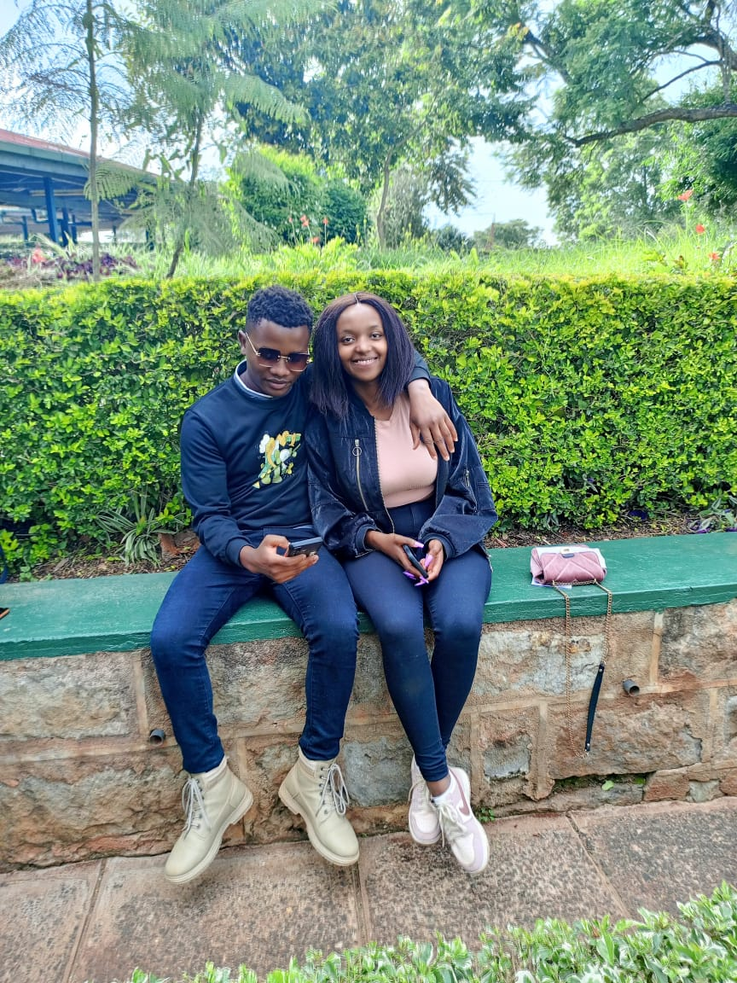
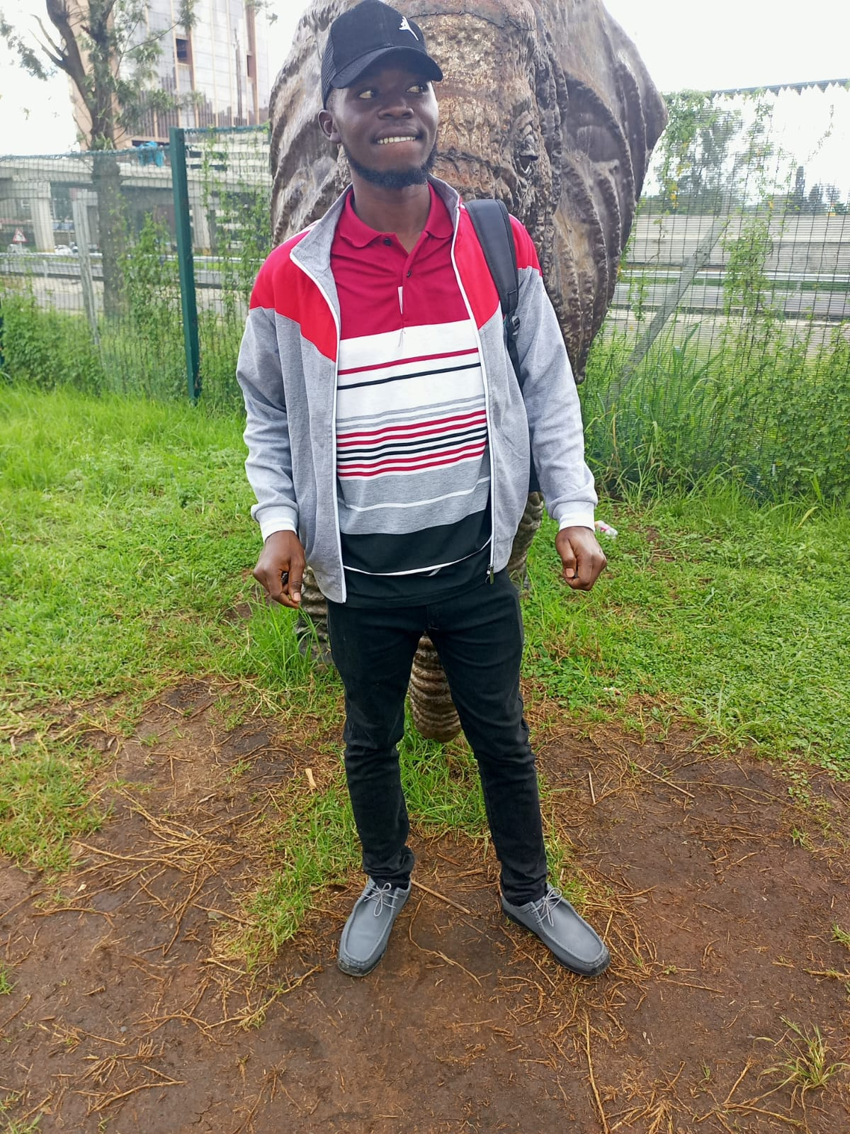
Personal Relationships and Support Systems
Kelvin Muriithi
Emily Mueni
Best friend and cousin Amos Safari Joseph.
Girlfriend Emily Mueni.
University friends Patrick Kiteme, Kelvin
Muriithi and Immaculate Mwihaki .
Immaculate
Patrick Kiteme
Amos Safari

Slide 9
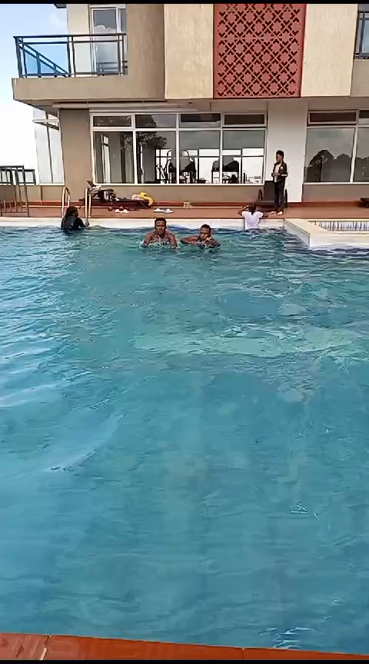
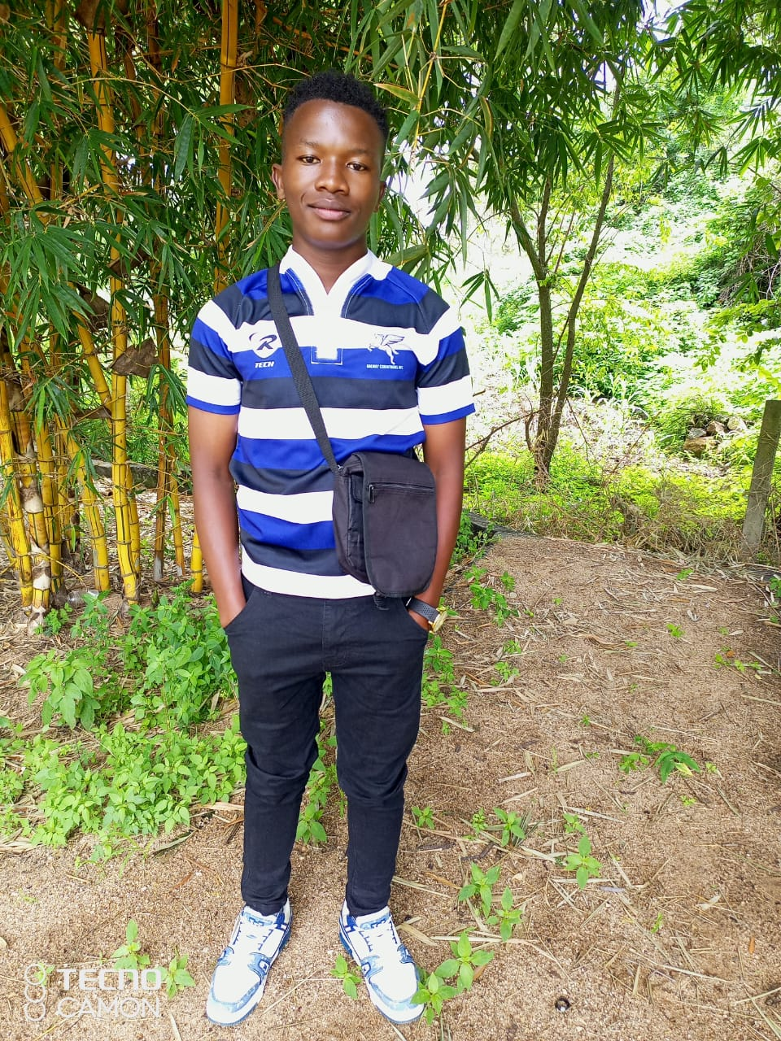
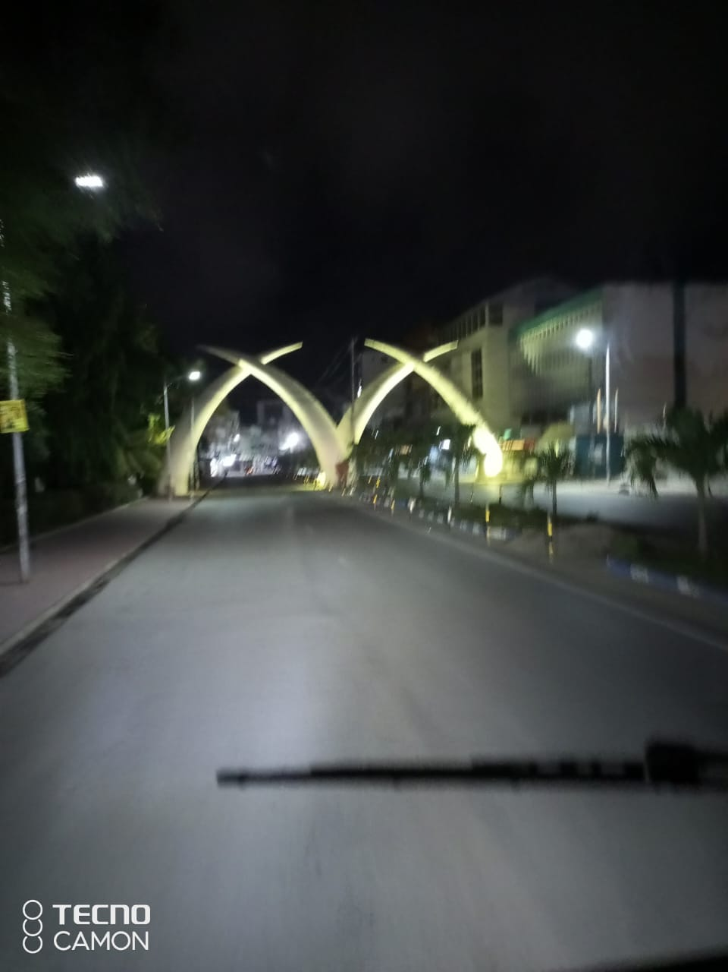
Hobbies and Interests
Football, swimming, reading, and traveling.
Places visited: Mombasa, Machakos, Kitale,
Nairobi, Nyeri, Nakuru, Eldoret, Kilifi.

Slide 10
Personal Growth and Development
Lessons learned from challenges and achievements.
Impact of family support and education.
Leadership and teamwork experiences.

Slide 11
Future Aspirations
Career goals in Business Information Technology.
Commitment to community service and environmental conservation.

Slide 12
Reflections on Growth and Resilience
Gratitude for experiences and support systems.
Commitment to continued learning and making a difference.

Slide 13
Reflections on Growth and Resilience
Gratitude for experiences and support systems.
Commitment to continued learning and making a difference.

Slide 14
Epilogue
Thanks to family, teachers, friends, and mentors.
Special mention of Mr. Ndeto, Amos Safari Joseph, Emily Mueni, Patrick Kiteme, and Kelvin Muriithi.

